Slide 1


Slide 2
React is ...
JavaScript Frontend framework
Developed by Facebook
Used by Facebook, Walmart, Airbnb, Uber, Discord...
One of the most popular npm modules with over 5 million weekly downloads

Slide 3
How React works?
Uses JSX
Relies on Babel
Works great with Webpack
Consists of React and ReactDOM
Everything is a Component
Most of React is just plain JavaScript

Slide 4
Installation
// option 1
$
// option 2
$
npm install react react-dom
npx create-react-app my-app

Slide 5

Keywords
- React and ReactDOM
- JSX
- Components
- Props
- States
- Lifecycle methods

Slide 6

REACT DOM

Slide 7
React is a library for creating user interfaces, while ReactDOM is a library for web apps that lets you manipulate DOM, just like jquery but in react style.
ReactDOM comes with many methods, but the most used one is render().
ReactDOM.render() is responsible for rendering our React components in a browser.
ReactDOM is written only once and placed in your main javascript file (app.js or index.js).

Slide 8
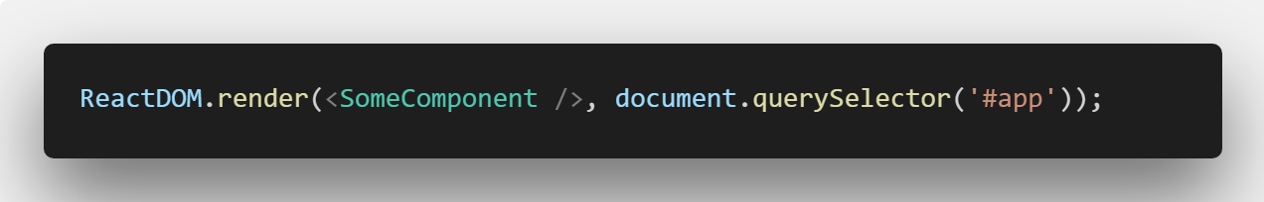
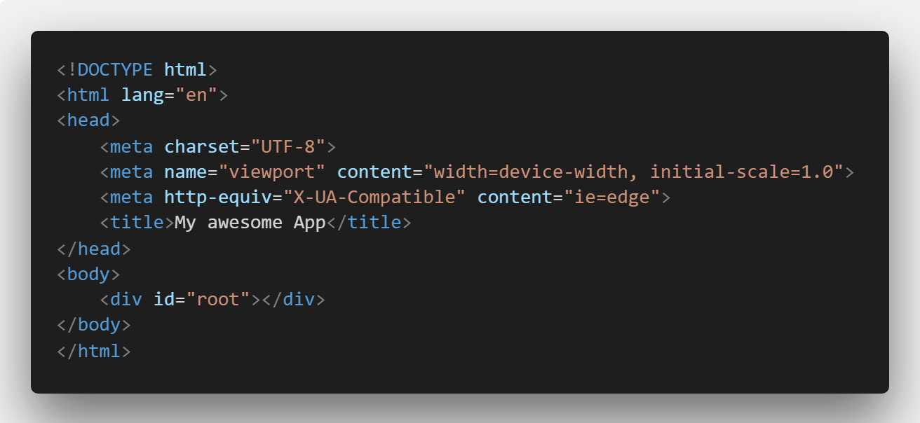

Slide 9
JSX

Slide 10
Short for JavaScript XML
Serves as a template engine
Very similar syntax to HTML with a few minor differences
Allows you to nest javascript within html

Slide 11


Hello React

Slide 12
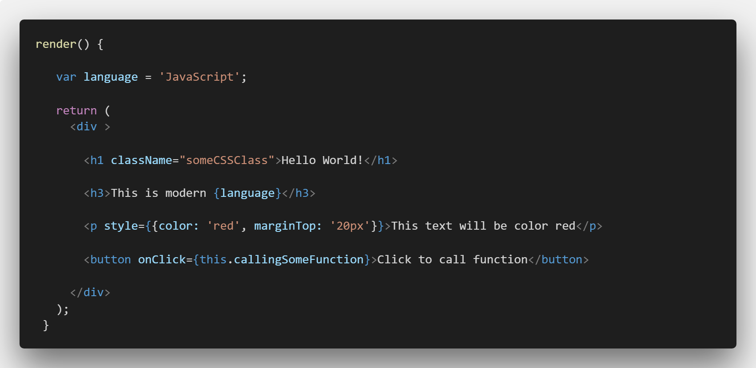
JSX vs HTML

Slide 13
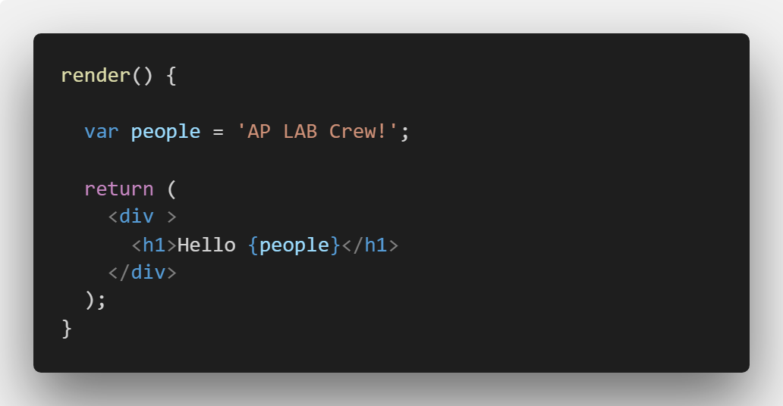
Nesting JavaScript within JSX

Slide 14
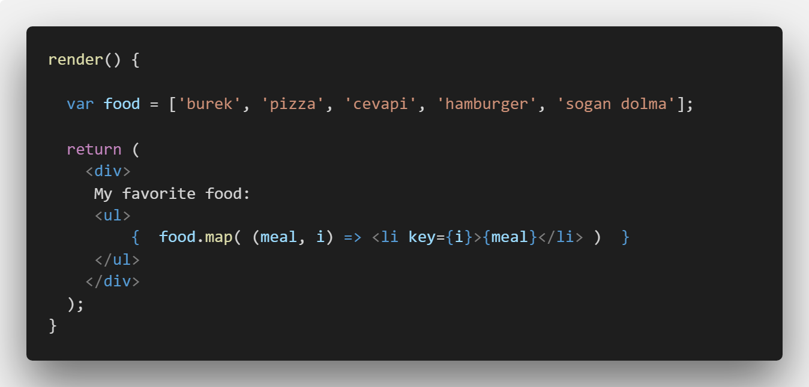
Looping through JSX

Slide 15
But there are limits
No declarations within JSX
No if / else statement withing JSX
That brings us to...

Slide 16
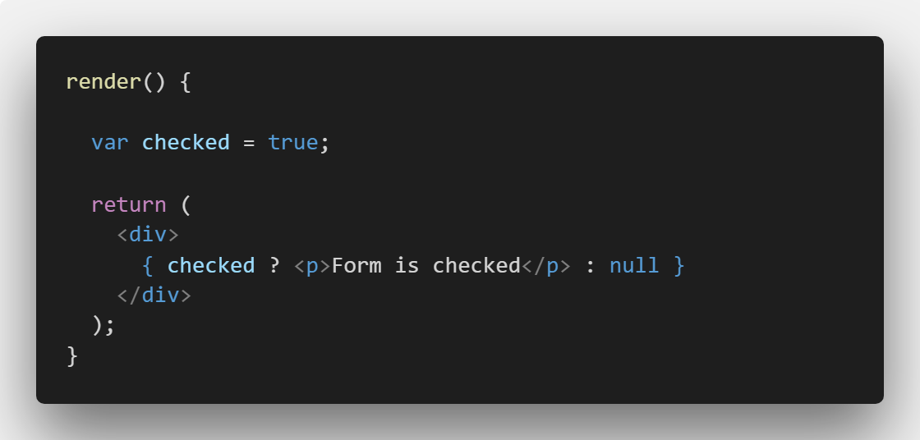
Ternary Operator!

Slide 17
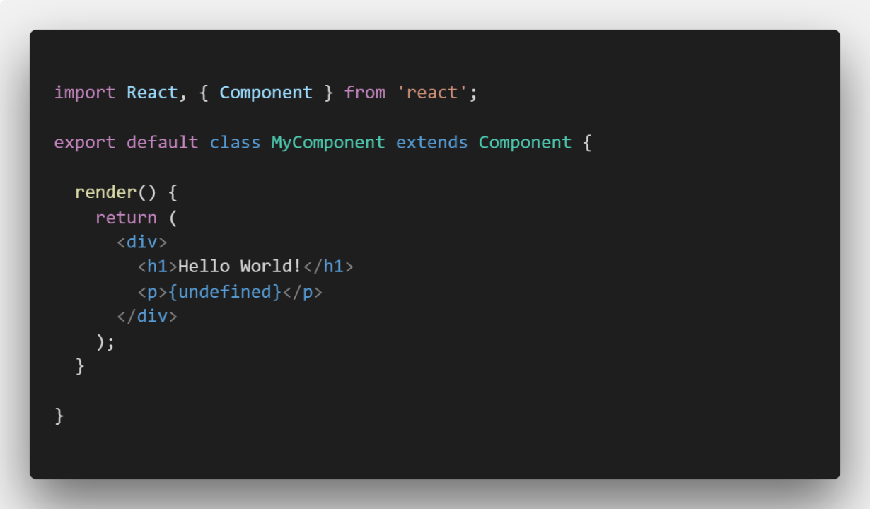
JSX ignores Booleans, null and undefined

Slide 18
COMPONENTS

Slide 19
Components let you split the UI into independent, reusable pieces, and think about each piece in isolation.
Two types of components in React:
Stateful (class components)
Stateless (functional components)

Slide 20


React vs World

Slide 21
First React Component

Slide 22
User-defined components must be Capitalized. When an element type starts with a lowercase letter, it refers to a built-in html element like <div> or <span>. To help React tell a difference between our components and html tags we capitalize our components.

Slide 23
Render function
Every stateful component has a render function
Render function retrurns JSX
We can only return one element
To return multiple elements we must wrap those elements in a <div> tag

Slide 24
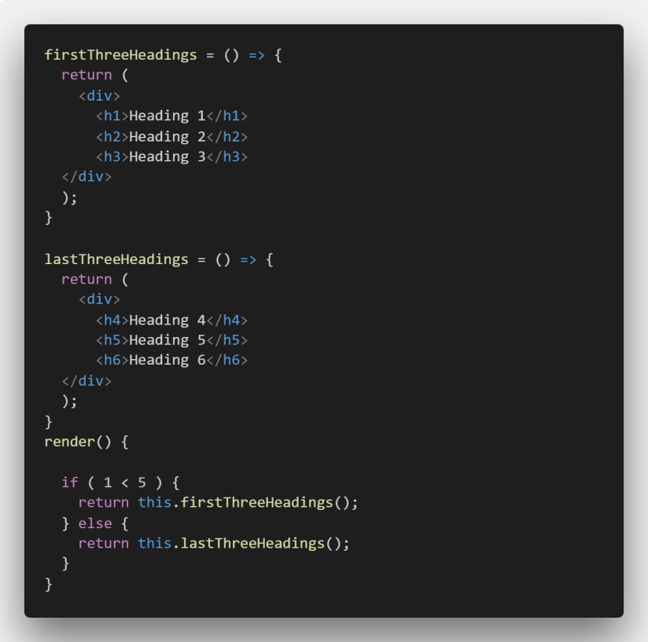
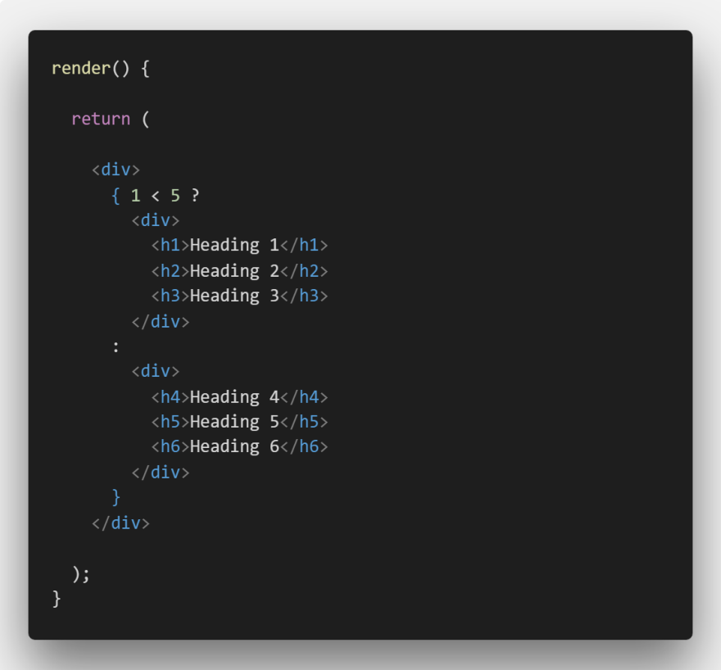
Conditional Rendering

Slide 25
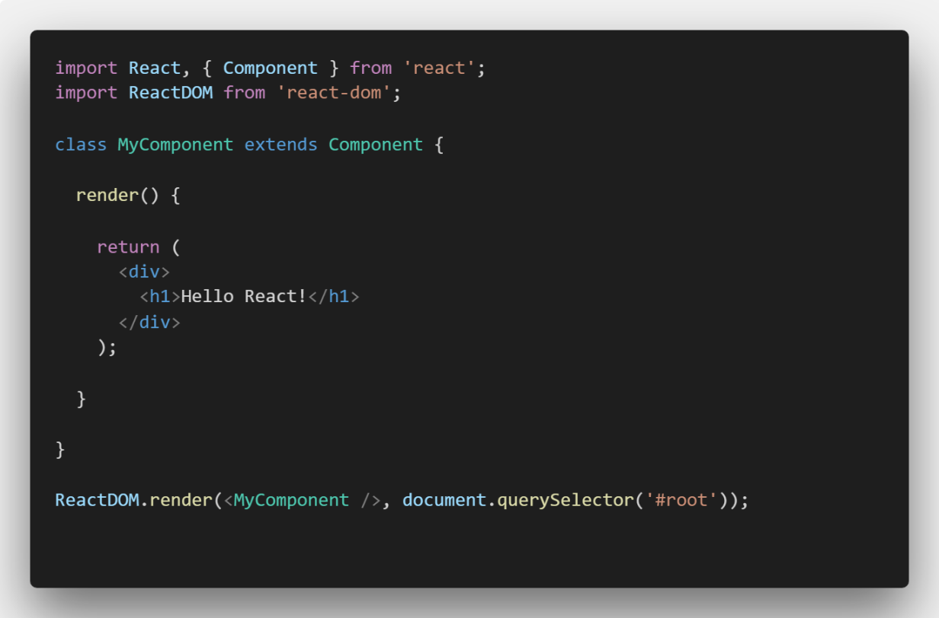
Stateful (class) component

Slide 26
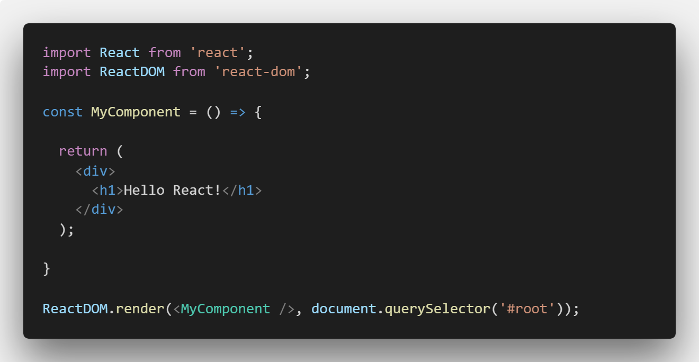
Stateless (functional) component

Slide 27
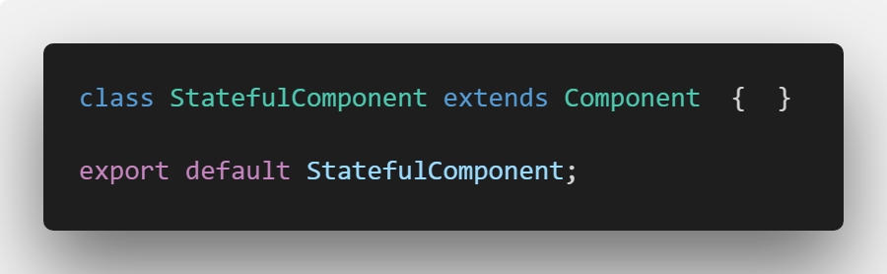
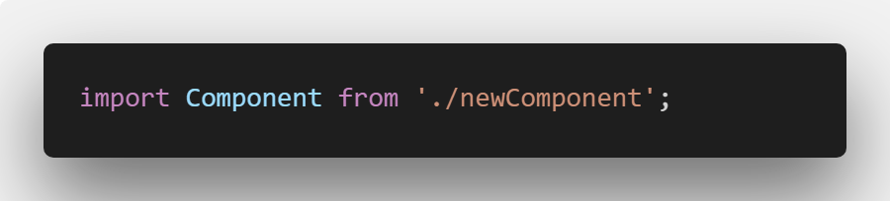
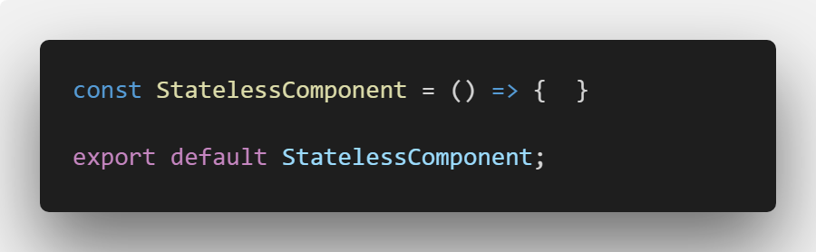
Importing and Exporting Components

Slide 28
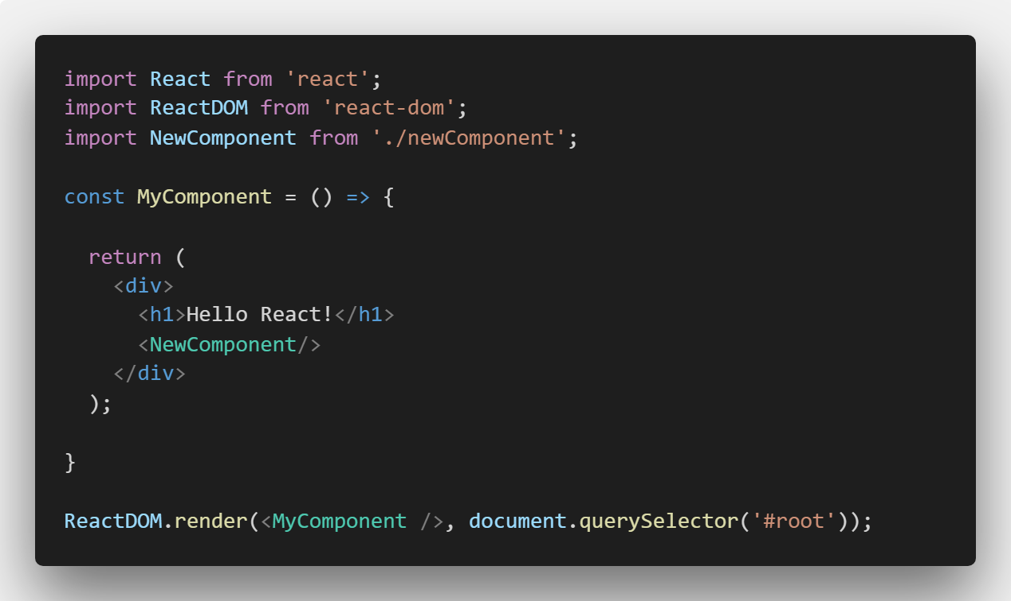
Nesting Components

Slide 29
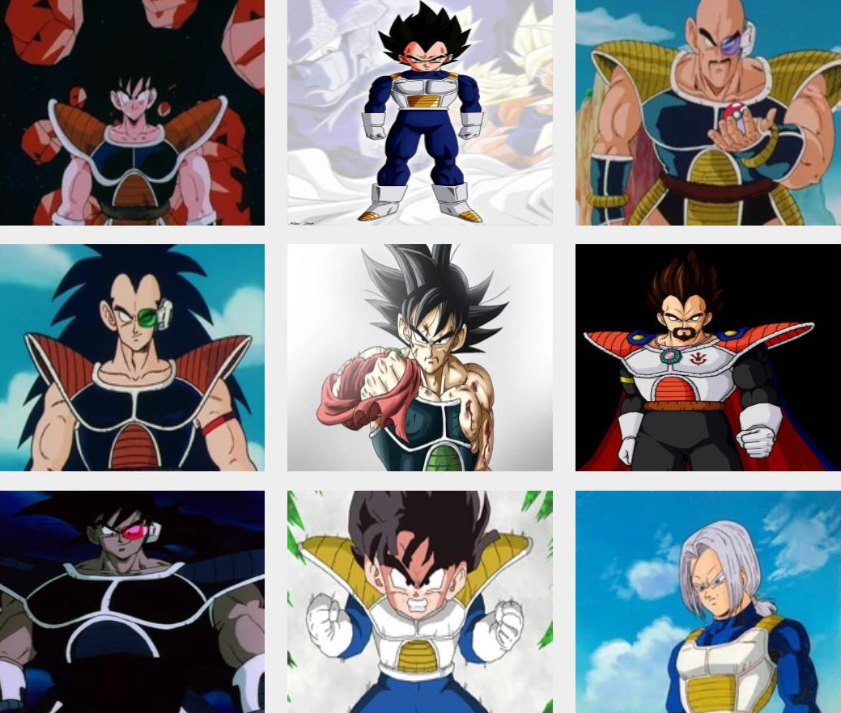
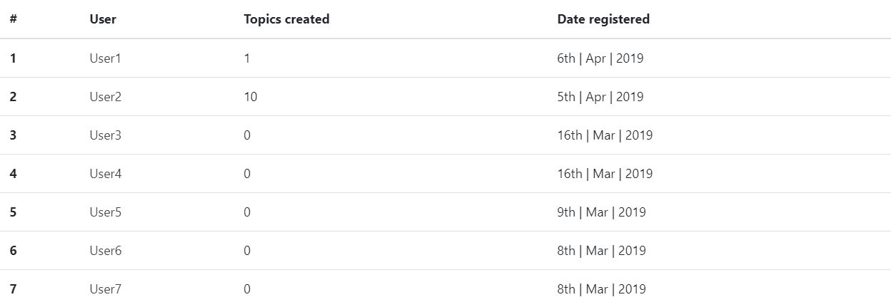
Using Stateless components

Slide 30
PROPS

Slide 31
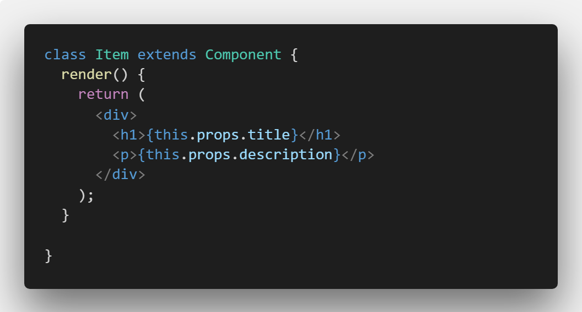
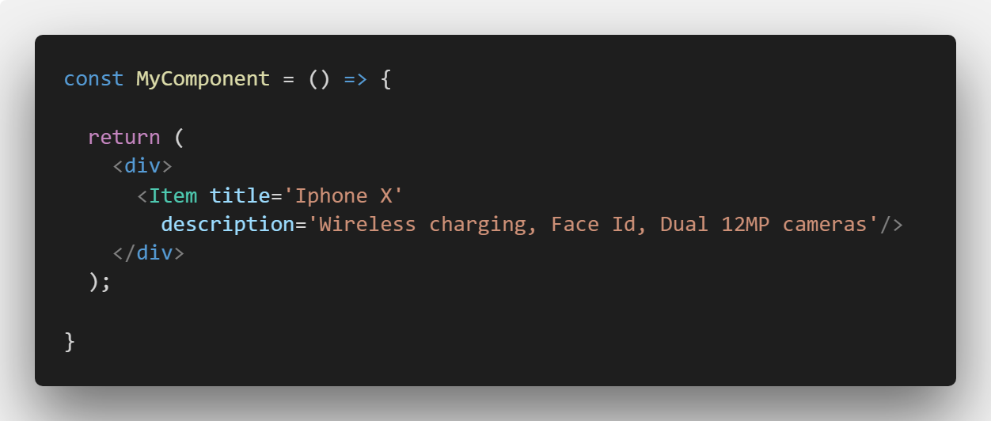
Props, short for Properties, represents a dynamic piece of data we pass to components and output it.
We use Props to pass the data from parent component to a child component.

Slide 32
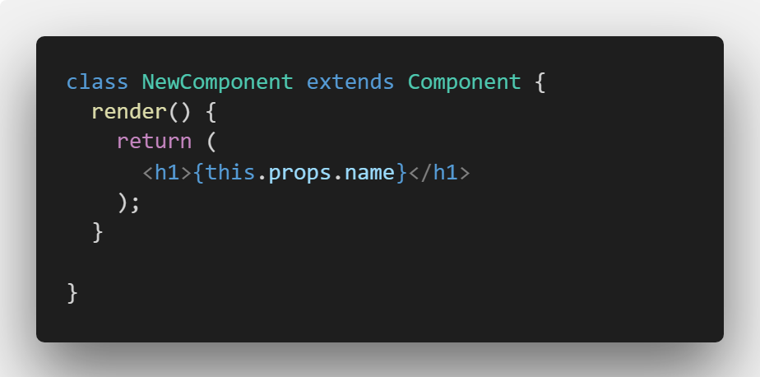
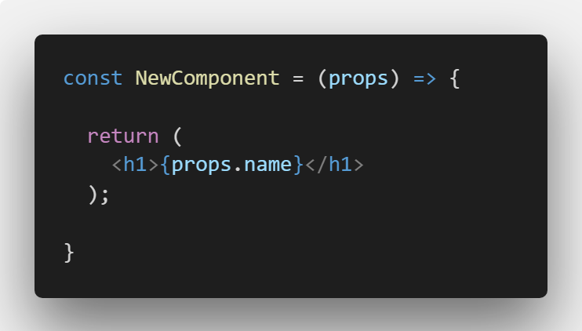
Using props
Stateful component
Stateless component

Slide 33
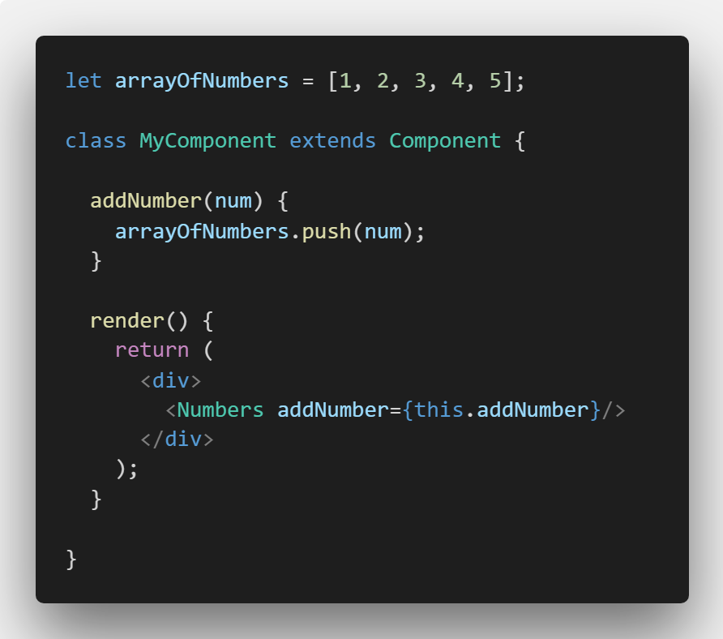
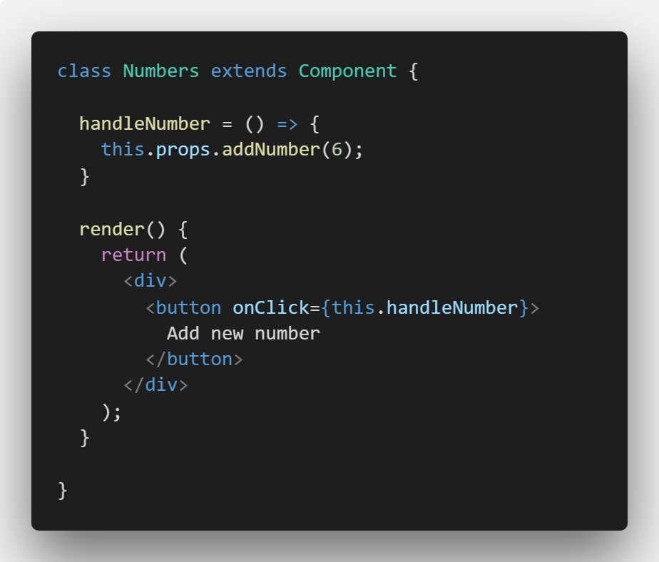
Functions as Props

Slide 34
CHILDREN

Slide 35
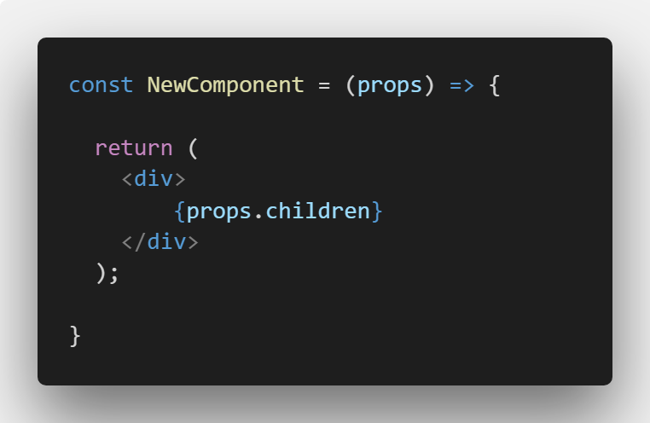
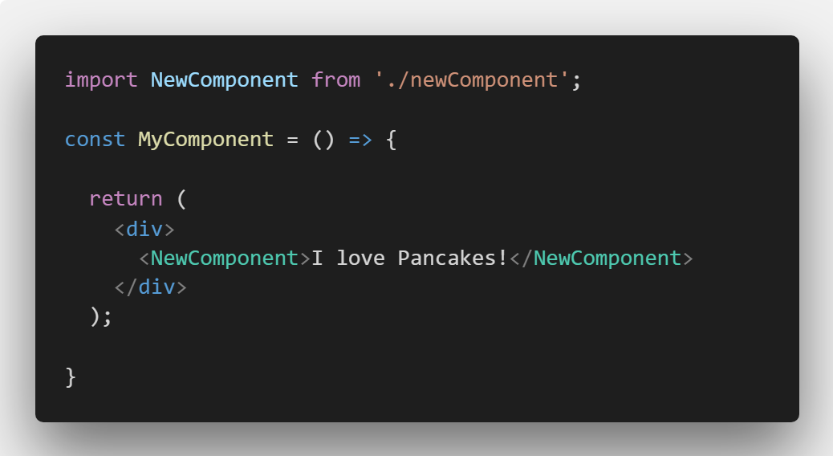
Component can declared with an opening and a closing tag.
Child of a component represents content between opening an a closing tag of a component.

Slide 36
STATES

Slide 37
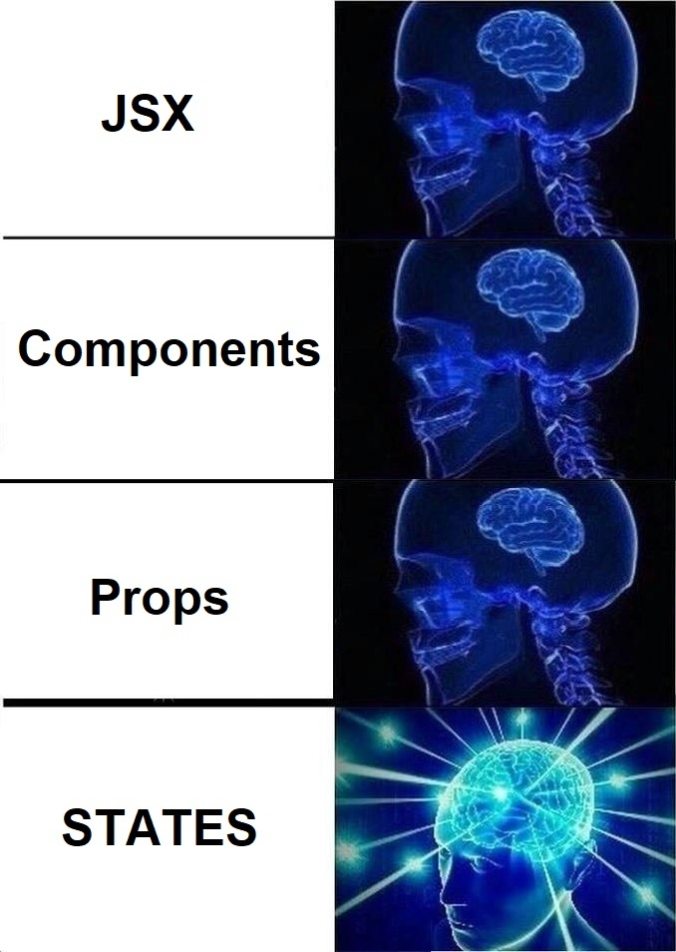
States are used for any kind of interaction within a component.
States can be used for simple things like button clicks to very complex user triggered events.
Every time we change a State React will update the component based on that change.

Slide 38
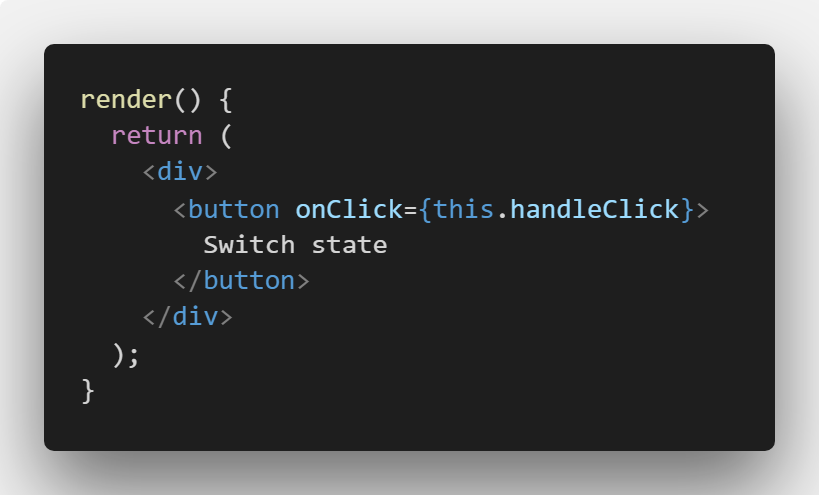
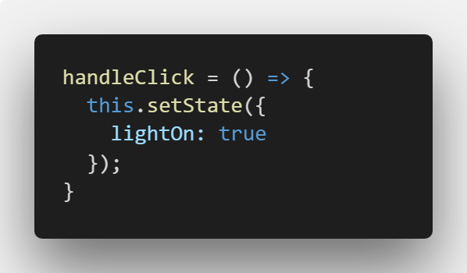
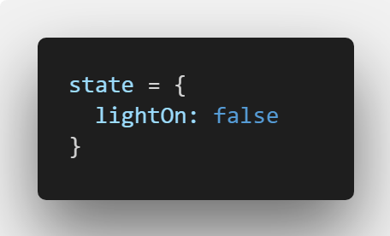
Working with States
We start by creating initial state
We create a trigger for the state change
We change the state
We update the component based on state changes

Slide 39
Create a Button

Slide 40
Create a Form

Slide 41
LIFECYCLE METHODS

Slide 42
Every component in React goes through a lifecycle. The Lifecycle methods are various methods which are invoked at different phases of the lifecycle of a component.
Some of the many Lifecycle methods in React:
render()
componentDidMount()
componentDidUpdate()
componentWillReceieveProps()
componenWillUnMount()

Slide 43
ASYNCHRONOUS JAVASCRIPT

Slide 44
AJAX
Working with asynchronous requests in React can be done in multiple ways:
XMLHttpRequest
Fetch API (Promises)
Axios (third party library)
Once asynchronous request arrives we update the state with new data and modify the page.

Slide 45
Working with API data

Slide 46
STYLING REACT

Slide 47
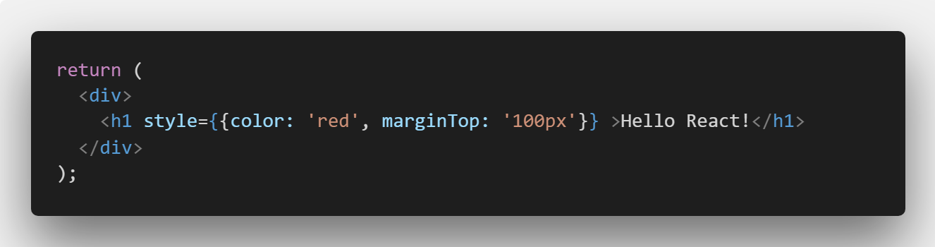
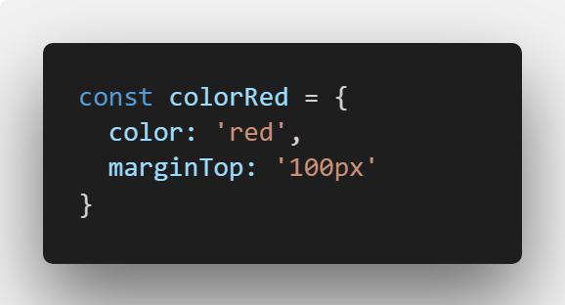
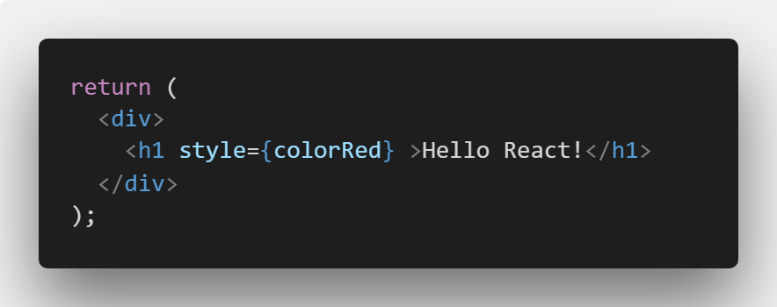
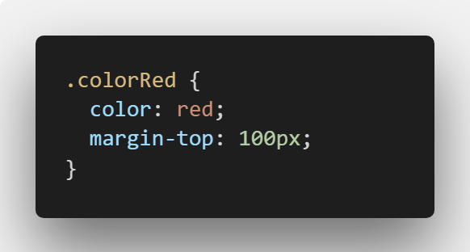
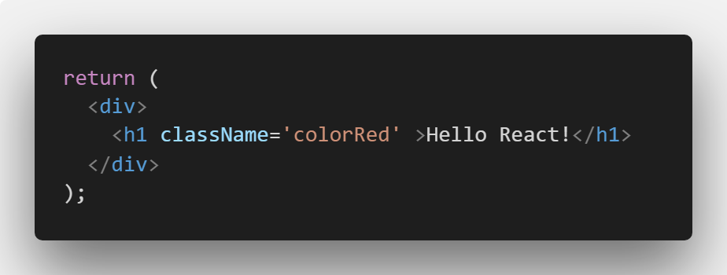
React components can be styled in multiple ways:
Inline style
Style through css, sass/less file
Style via third party library

Slide 48
STYLED COMPONENTS

Slide 49
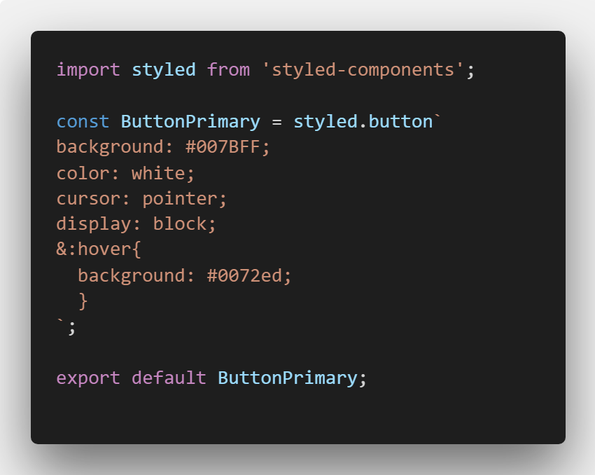
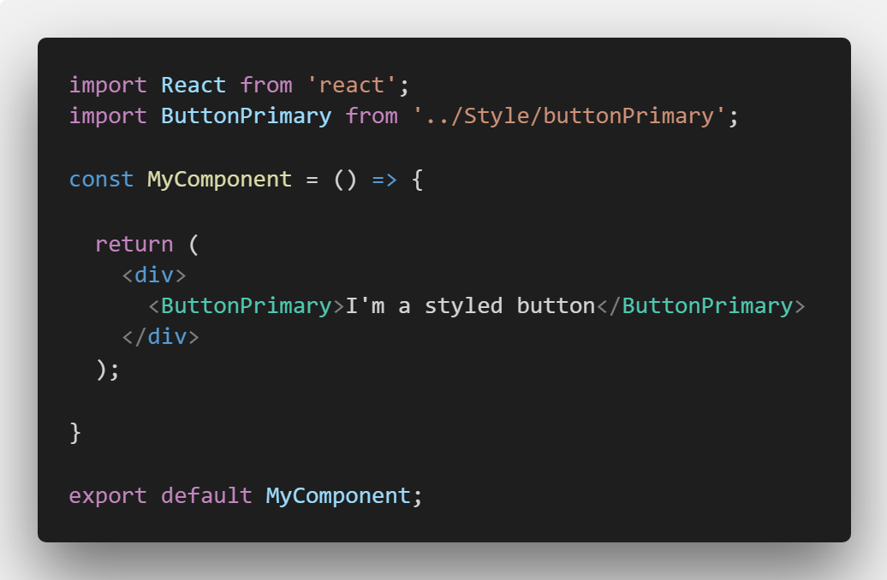
Styled Components is a third party library for styling React components. The idea is to create a component of type HTML element, style it and then reuse that element (now styled) as a component throughout our project.

Slide 50
REACT BOOTSTRAP

Slide 51
React has it‘s own Bootstrap library called React Bootstrap.
React bootstrap replaces the Bootstrap javascript. Each component has been built from scratch as true React components, without uneeded dependencies like jQuery.
https://react-bootstrap.github.io
There is also an alternative called Reactstrap, easy to use React Bootstrap 4 components compatible with React.
https://reactstrap.github.io

Slide 52
TIPS AND TRICKS

Slide 53
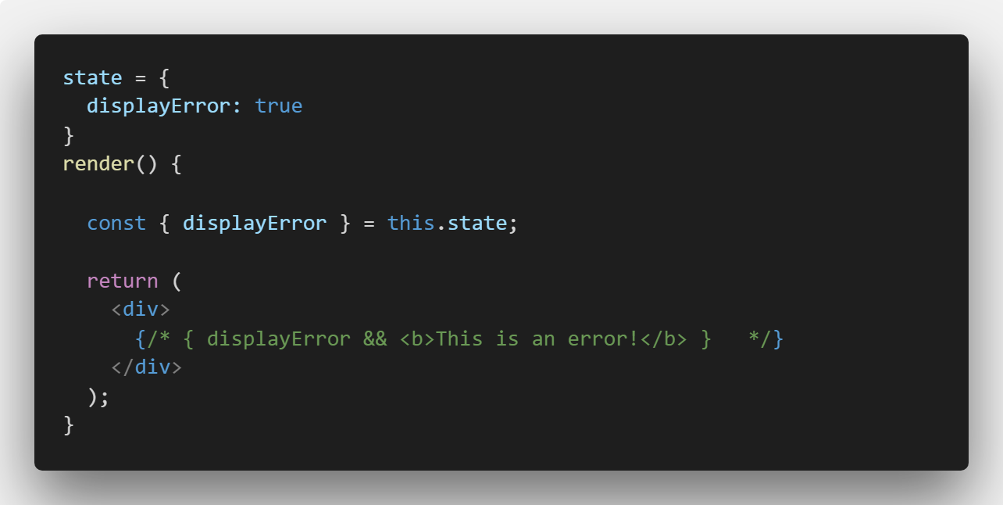
Comments in JSX

Slide 54
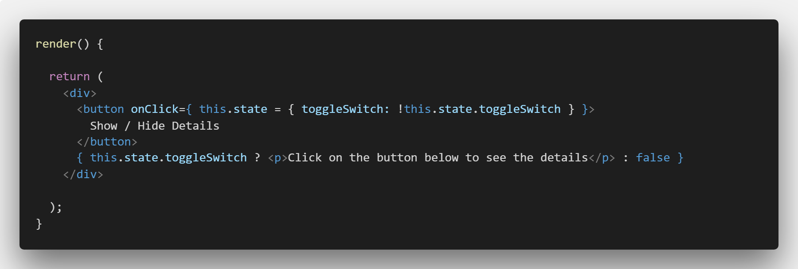

Don‘t do this

Slide 55
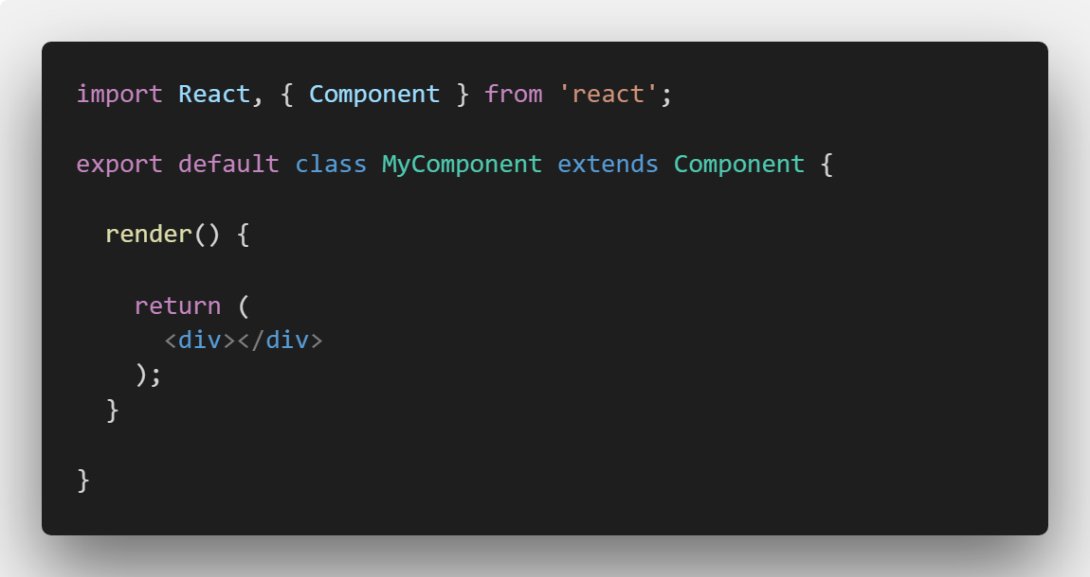
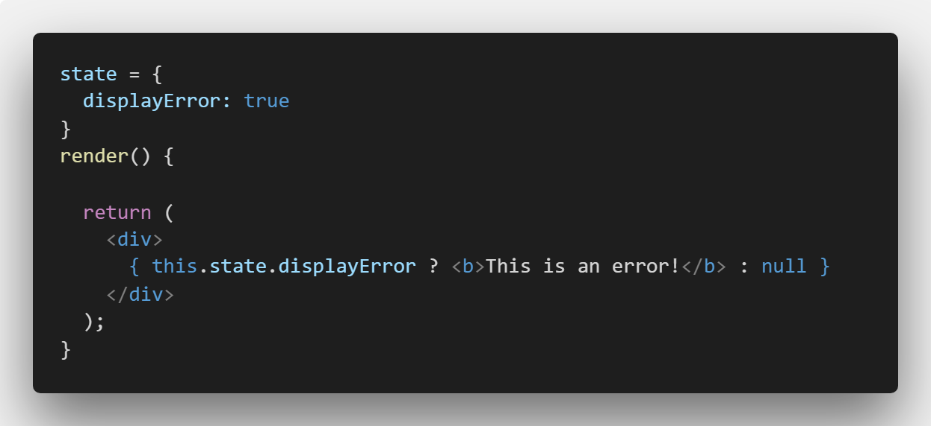
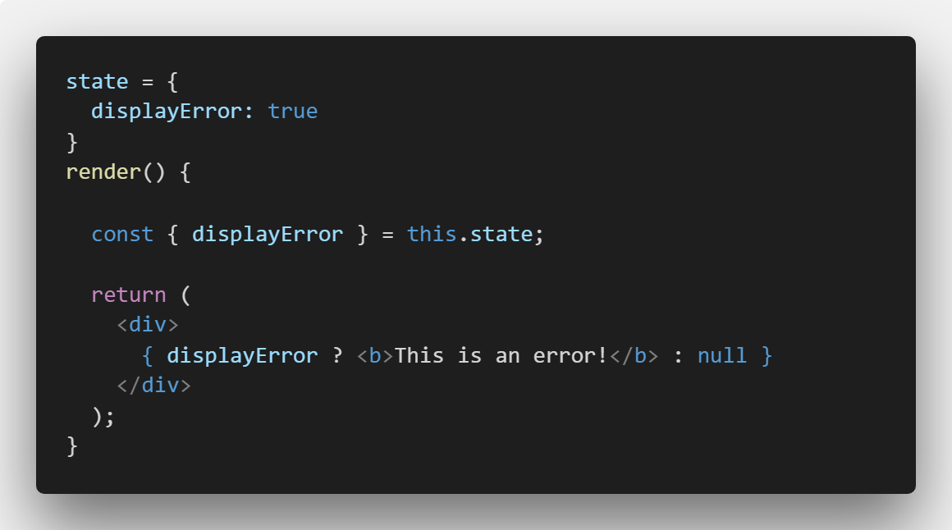
Use ES6 Destructuring
After
destructuring:
Before destructuring:
We were using destructuring all along

Slide 56
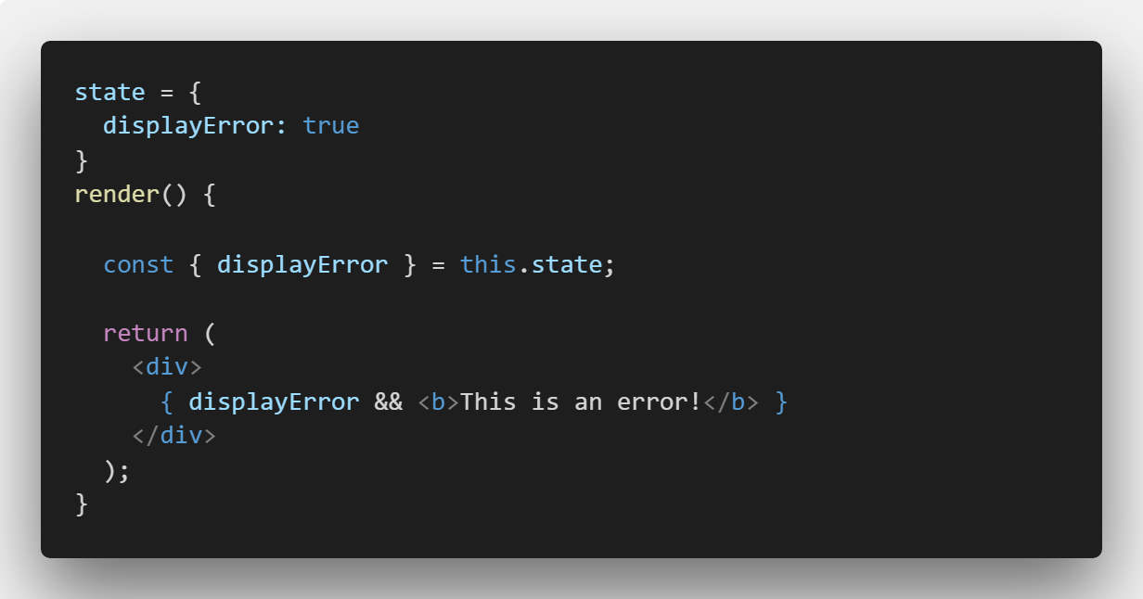
&& vs ||
console.log(‘Zeljeznicar' || ‘Sarajevo‘);
// output: Zeljeznicar
console.log(‘Zeljeznicar' && ‘Sarajevo‘);
// output: Sarajevo
Implementing option two, we get the following result:

Slide 57

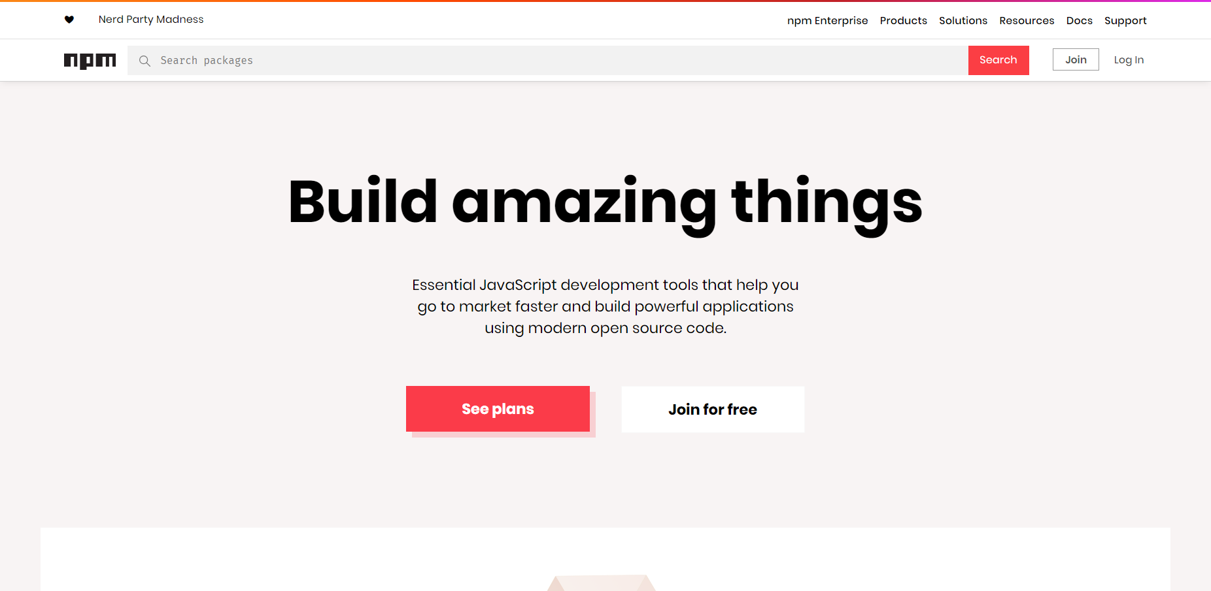
Use npm modules

Slide 58

React Dev Tools

Slide 59
ADVANCED TOPICS

Slide 60
React Router (single page apps)
Firebase (database as a service)
React Flow (quite similar to TypeScript)
React Suspense and Lazy (split code into bundles)
Context API (easier state management)
Redux, MobX and Flux (libraries for state management)
React Hooks (write components without a class)

Slide 61
Where to learn React
Udemy - Andrew Mead - Steven Grider - Maximilian Schwarzmüller
Youtube - The Net Ninja - TylerMcGinnis - TheNewBoston (outdated, but useful)
ReactJS Docs https://reactjs.org/docs/getting-started.html

Slide 62
Source material
Presentation and demos:
https://github.com/MirzaLeka/ReactLab
Contact
JavaScript enthusiast? Tell me everything about it!
https://twitter.com/mirzaleka
https://medium.com/@mirzaleka

Slide 63


